Slide 1






Agenda
What’s a Microcontroller?
Types of Microcontrollers
Features and Internal structure of PIC 16F877A Instruction Execution
1

Slide 2
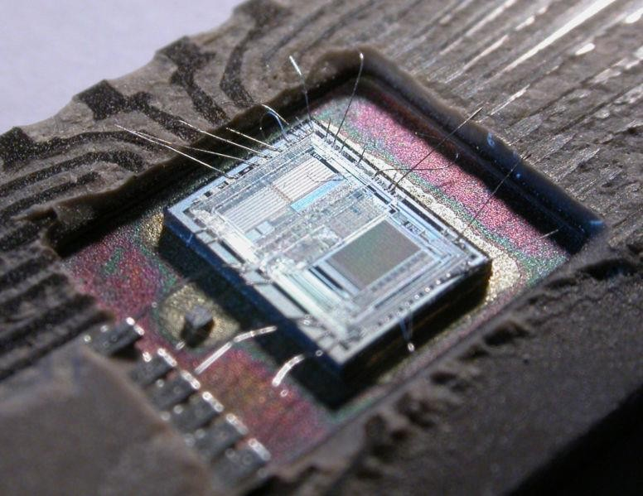
What is a microcontroller?
A microcontroller (sometimes abbreviated µC, uC or MCU) is a small computer on a single integrated circuit containing a processor core, memory, and programmable input/output peripherals.
It can only perform simple/specific tasks.
A microcontroller is often described as a ‘computer-on-a- chip’.
2

Slide 3
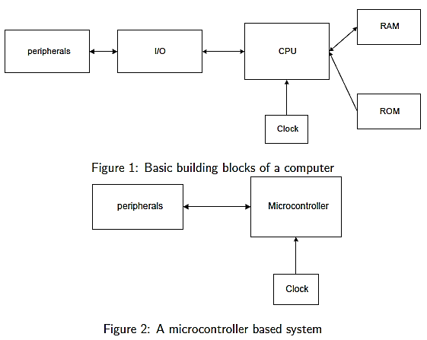
Microcomputer system and Microcontroller based system
3

Slide 4
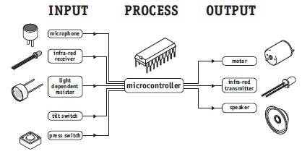
Microcontrollers..
Microcontrollers are purchased ‘blank’ and then programmed
with a specific control program.
Once programmed the microcontroller is build into a product to make the product more intelligent and easier to use.
A designer will use a Microcontroller to:
Gather input from various sensors
Process this input into a set of actions
Use the output mechanisms on the microcontroller to do
something useful.
4

Slide 5
Types of Microcontrollers
Parallax Propeller
Freescale 68HC11 (8-bit)
Intel 8051
Silicon Laboratories Pipelined 8051 Microcontrollers
ARM processors (from many vendors) using ARM7 or Cortex-M3 cores are generally microcontrollers
STMicroelectronics STM8 (8-bit), ST10 (16-bit) and STM32 (32-bit)
Atmel AVR (8-bit), AVR32 (32-bit), and AT91SAM (32-bit)
Freescale ColdFire (32-bit) and S08 (8-bit)
Hitachi H8, Hitachi SuperH (32-bit)
Hyperstone E1/E2 (32-bit, First full integration of RISC and DSP on one processor core [1996])
Infineon Microcontroller: 8, 16, 32 Bit microcontrollers for
automotive and industrial applications.
5

Slide 6
Types of Microcontrollers..
MIPS (32-bit PIC32)
NEC V850 (32-bit)
Microchip PIC (8-bit PIC16, PIC18, 16-bit dsPIC33/PIC24)
PowerPC ISE
PSoC (Programmable System-on-Chip)
Rabbit 2000 (8-bit)
Texas Instruments Microcontroller MSP 430 (16-bit), C2000 (32-bit),
and Stellaris (32-bit)
Toshiba TLCS-870 (8-bit/16-bit)
Zilog eZ8 (16-bit), eZ80 (8-bit)
etc
6

Slide 7
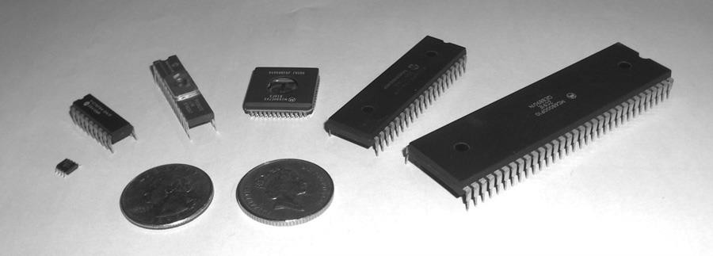
Microcontroller Packaging and Appearance
From left to right: PIC 12F508, PIC 16F84A, PIC 16C72, Motorola 68HC05B16, PIC 16F877,
Motorola 68000
8

Slide 8
PIC Microcontrollers
Peripheral Interface Controller (PIC) was originally designed by
General Instruments
In the late 1970s, GI introduced PIC® 1650 and 1655 – RISC with 30 instructions.
PIC was sold to Microchip
Features: low-cost, self-contained, 8-bit, Harvard structure, pipelined, RISC, single accumulator, with fixed reset and interrupt vectors.

Slide 9
PIC Microcontroller product family
8-bit microcontrollers
PIC10
PIC12
PIC14
PIC16
PIC17
PIC18
16-bit microcontrollers
PIC24F
PIC24H
32-bit microcontrollers
PIC32
16-bit digital signal
controllers
dsPIC30
dsPIC33F

Slide 10
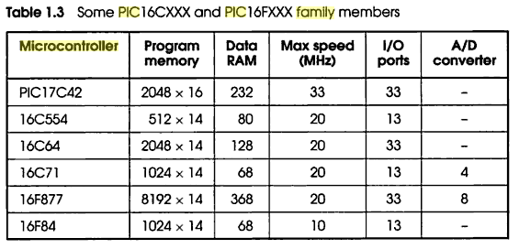
PIC Microcontroller product family..
The F in a name generally indicates the PICmicro uses flash
memory and can be erased electronically.
The C generally means it can only be erased by exposing the die to ultraviolet light (which is only possible if a windowed package style is used). An exception to this rule is the PIC16C84 which uses EEPROM and is therefore electrically erasable.

Slide 11
An Example: PIC16F877
Why PIC16F877A is very popular?
This is because PIC16F877A is very cheap. Apart from that it is also very easy to be assembled. Additional components that you need to make this IC work is just a 5V power supply adapter, a 20MHz crystal oscillator and 2 units of 22pF capacitors.
What is the advantages of PIC16F877A?
This IC can be reprogrammed and erased up to 10,000 times.
Therefore it is very good for new product development phase.
What is the disadvantages of PIC16F877A?
This IC has no internal oscillator so you will need an external crystal of other clock source.
12

Slide 12
Key Features | PIC16F877
MAX Operating Frequency | 20MHz
FLASH Program Memory (14-bit words) | 8K
Data Memory (bytes) | 368
EEPROM Data Memory (bytes) | 256
I/O Ports | RA0-5 (6) RB0-7 (8) RC0-7 (8) RD0-7 (8) RE0-2 (3)
Timers | 3
CCP ( Capture/Compare/PWM) | 2
Serial Communications | MSSP, USART
Parallel Communications | PSP
10-bit Analog-to-Digital Module | 8 Channels
Instruction Set | 35 Instructions
Pins (DIP) | 40 Pins
Features
13

Slide 13

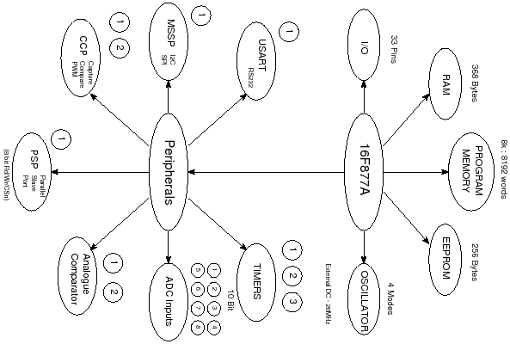
Bubble diagram of PIC16F877
14

Slide 14
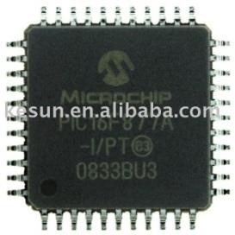
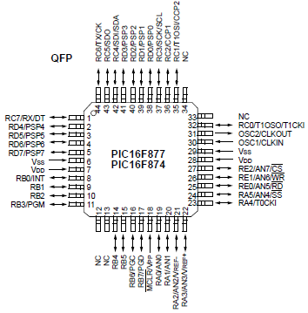
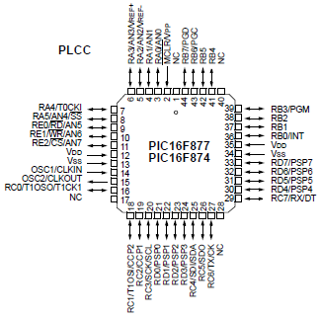
Pin Diagram of PIC16F877
Quad Flat Package (QFP)
Plastic Leaded Chip Carrier Package (PLCC)

Slide 15
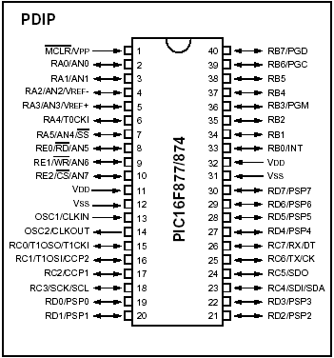
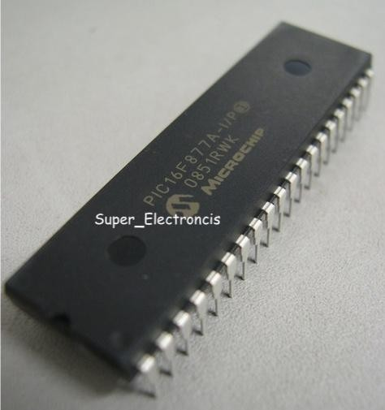
Pin Diagram of PIC16F877..
Plastic dual in-line package (DIP)

Slide 16
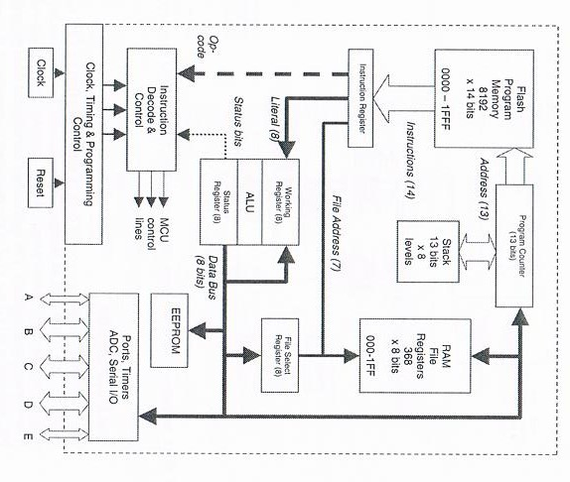
PIC16F877
Architecture
17
RTES, Lec#3 , Spring 2015
© Ahmad El-Banna

Slide 17
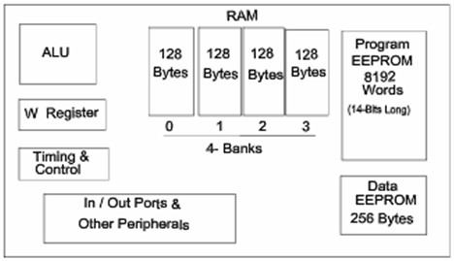

PIC16F877 Internal Block Diagram
© Ahmad El-Banna
The basic architecture of PIC16F877 consists of Program
memory, file registers and RAM, ALU and CPU registers.
RTES, Lec#3 , Spring 2015
18

Slide 18
Memory of the PIC16F877
© Ahmad El-Banna
divided into 3 types of memories:
Program Memory – A memory that contains the program (which we had written), after we've burned it. As a reminder, Program Counter executes commands stored in the program memory, one after the other.
Data Memory – This is RAM memory type, which contains a special registers like SFR (Special Function Register) and GPR (General Purpose Register). The variables that we store in the Data Memory during the program are deleted after we turn off the micro. These two memories have separated data buses, which makes the access to each one of them very easy.
Data EEPROM (Electrically Erasable Programmable Read- Only Memory) – A memory that allows storing the variables as a result of burning the written program.
RTES, Lec#3 , Spring 2015
19

Slide 19
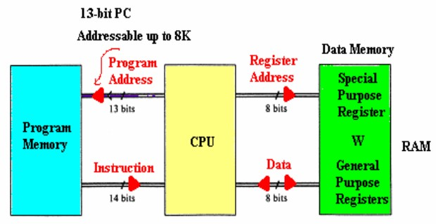
Memory of the PIC16F877..
© Ahmad El-Banna
Each one of them has a different role. Program Memory and Data Memory two memories that are needed to build a program, and Data EEPROM is used to save data after the microcontroller is turn off.
RTES, Lec#3 , Spring 2015
20

Slide 20
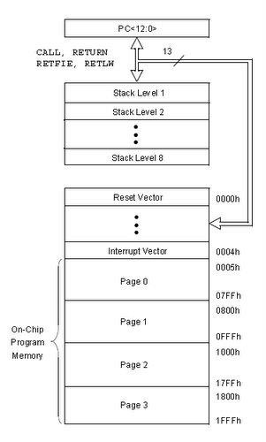
PIC16F877A
Program Memory
© Ahmad El-Banna
Is Flash Memory
Used for storing
compiled code (user’s program)
Program Memory
capacity is 8K x 14 bit →
Each location is 14 bits long
→ Every instruction is
coded as a 14 bit word
PC can address up to 8K addresses
Addresses H’000’ and
H’004’ are treated in a special way
RTES, Lec#3 , Spring 2015
21

Slide 21
PIC16F877A Data Memory (RAM)
© Ahmad El-Banna
Memory storage for variables
Data Memory is also known as Register File and consists of two components.
General purpose register file (same as RAM).
Special purpose register file (similar to SFR in 8051).
Addresses range from 0 to 511 and partitioned into 4 banks
→ each bank extends up to 7Fh (128 bytes).
The user can only access a RAM byte in a set of 4 banks and
only one bank at a time. The default bank is BANK0.
To access a register that is located in another bank, one should access it inside the program. There are special registers which can be accessed from any bank, such as STATUS register.
RTES, Lec#3 , Spring 2015
22

Slide 22
PIC16F877A Registers
© Ahmad El-Banna
Some CPU Registers:
W
PC
FSR
IDF
PCL
PCLATH
STATUS
RTES, Lec#3 , Spring 2015

Slide 23
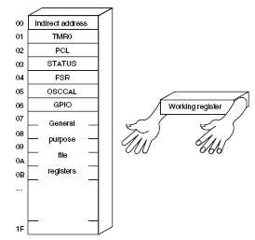
W Register
© Ahmad El-Banna
W, the working register, is used by many instructions as the
source of an operand. This is similar to accumulator in 8051.
It may also serve as the destination for the result of the instruction execution. It is an 8-bit register.
RTES, Lec#3 , Spring 2015

Slide 24
Program Counter
© Ahmad El-Banna
Program Counter (PC) is 13 bit and capable of addressing an 8K word
x 14 bit program memory space.
PC keeps track of the program execution by holding the address of the current instruction.
It is automatically incremented to the next instruction during the
current instruction execution.
RTES, Lec#3 , Spring 2015
Program Counter Stack
an independent 8-level stack is used for the program counter.
As the PC is 13-bit, the stack is organized as 8x13bit registers.
When an interrupt occurs, the PC is pushed onto the stack. When the interrupt is being served, other interrupts remain disabled. Hence, other 7 registers of the stack can be used for subroutine calls within an interrupt service routine or within the mainline program.
25

Slide 25
FSR & INDF
© Ahmad El-Banna
FSR Register
(File Selection Register, address = 04H, 84H)
is an 8-bit register used as data memory address pointer. This
is used in indirect addressing mode.
RTES, Lec#3 , Spring 2015
INDF Register
(INDirect through FSR, address = 00H, 80H)
INDF is not a physical register. Accessing INDF is actually access the location pointed to by FSR in indirect addressing mode.
26

Slide 26
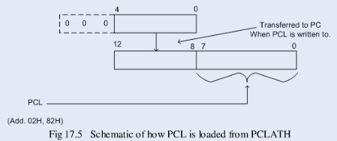
PCL & PCLATH
© Ahmad El-Banna
PCL Register
(Program Counter Low Byte, address =02H, 82H)
PCL is actually the lower 8-bits of the 13-bit Program Counter. This is a both readable and writable register.
PCLATH Register
(Program Counter LATcH, address = 0AH, 8AH)
PCLATH is a 8-bit register which can be used to decide the upper 5-bits of the PC. PCLATH is not the upper 5bits of the PC. PCLATH can be read from or written to without affecting the PC. The upper 3 bits of PCLATH remain zero and they serve no purpose. When PCL is written to, the lower 5bits of PCLATH are automatically loaded to the upper 5bits of the PC.
RTES, Lec#3 , Spring 2015

Slide 27
Memory Map Registers
© Ahmad El-Banna
In order to start programming and build automated system, there is no need to study all the registers of the memory map, but only a few most important ones:
STATUS register – changes/moves from/between the
banks.
PORT registers – assigns logic values (“0”/”1”) to the ports
TRIS registers – data direction register (input/output)
RTES, Lec#3 , Spring 2015

Slide 28

STATUS Register
© Ahmad El-Banna
Is an 8-bit register that stores the status of the processor.
In most cases, this register is used to switch between the banks (Register Bank Select), but also has other capabilities.
RTES, Lec#3 , Spring 2015
IRP - Register Bank Select bit.
RP1:RP0: - Register Bank Select bits.
TO: Time-out bit
PD: Power-down bit
Z: Zero bit
DC: Digit carry/borrow bit
C: Carry/borrow bit
Used in conjunction with PIC’s sleep mode
29

Slide 29
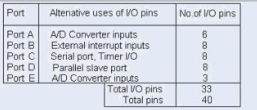
PIC16F877 Peripheral features
© Ahmad El-Banna
I/O Ports:
PIC16F877 has 5 I/O ports:
PORT A has 6 bit wide, Bidirectional
PORT B, C, D have 8 bit wide, Bidirectional
PORT E has 3 bit wide, Bidirectional
In addition, they have the following alternate functions:
RTES, Lec#3 , Spring 2015

Slide 30
PIC16F877 Peripheral features..
© Ahmad El-Banna
Each port has 2 control registers:
TRISx sets whether each pin is an input(1) or output(0)
PORTx sets their output bit levels or contain their input bit levels.
Pin functionality “overloaded” with other features.
Most pins have 25mA source/sink thus it can drive LEDs directly.
RTES, Lec#3 , Spring 2015

Slide 31
PIC16F877 Peripheral features…
© Ahmad El-Banna
Analog to Digital Converter (ADC)
Only available in 14bit and 16bit cores
Fs (sample rate) < 54KHz
The result is a 10 bit digital number
Can generate an interrupt when ADC conversion is done
The A/D module has 4 registers:
A/D Result High Register (ADRESH)
A/D Result Low Register (ADRESL)
A/D Control Register0 (ADCON0)
A/D Control Register1 (ADCON1)
Multiplexed 8 channel inputs
Must wait T _{acq} to change up sampling capacitor.
Can take a reference voltage different from that of the
controller.
RTES, Lec#3 , Spring 2015
32

Slide 32
PIC16F877 Peripheral features….
© Ahmad El-Banna
Timer/counter modules
Generate interrupts on timer overflow
Can use external pins as clock in/ clock out (ie. for counting
events or using a different Fosc)
There are 3 Timer/counter modules:
Timer0: 8-bit timer/counter with 8-bit pre-scaler
Timer1: 16-bit timer/counter with 8-bit pre-scaler, can be
incremented during SLEEP via external crystal/clock
Timer2: 8-bit timer/counter with 8-bit period register, pre-scaler and post-scaler.
RTES, Lec#3 , Spring 2015
33

Slide 33
PIC16F877 Peripheral features…..
© Ahmad El-Banna
Universal Synchronous Asynchronous Receiver
Transmitter (USART/SCI) with 9-bit address detection.
Asynchronous communication: UART (RS 232 serial)
Can do 300bps – 115kbps
8 or 9 bits, parity, start and stop bits, etc.
Outputs 5V → needs a RS232 level converter (e.g MAX232)
Synchronous communication: i.e with clock signal
SPI = Serial Peripheral Interface
3 wire: Data in, Data out, Clock
Master/Slave (can have multiple masters)
Very high speed (1.6Mbps)
Full speed simultaneous send and receive (Full duplex)
I2C = Inter IC
2 wire: Data and Clock
Master/Slave (Single master only)
Lots of cheap I2C chips available; typically < 100kbps
RTES, Lec#3 , Spring 2015
34

Slide 34
PIC16F877 Peripheral features…..
© Ahmad El-Banna
Capture, Compare, PWM modules
Capture is 16-bit, max. resolution is 12.5 ns
Compare is 16-bit, max. resolution is 200 ns
PWM max. resolution is 10-bit
Parallel Slave Port (PSP) 8-bits wide, with external RD, WR and CS controls
RTES, Lec#3 , Spring 2015

Slide 35
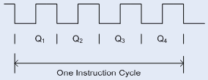
Clock and Instruction Cycles
© Ahmad El-Banna
Clock from the oscillator enters a microcontroller via OSC1 pin where internal circuit of a microcontroller divides the clock into four even clocks Q1, Q2, Q3 and Q4 which do not overlap.
These four clocks make up one instruction cycle (also called
machine cycle) during which one instruction is executed.
RTES, Lec#3 , Spring 2015

Slide 36
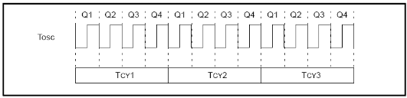
Clock and Instruction Cycles..
© Ahmad El-Banna
Execution of instruction starts by calling an instruction that is next in
string.
Instruction is called from program memory on every Q1 and is written in Instruction Register (IR) on Q4.
Decoding and execution of instruction are done between the next Q1 and Q4 cycles. The following diagram shows the relationship between instruction cycle and clock of the oscillator (OSC1) as well as that of internal clocks Q1 – Q4.
Program Counter (PC) holds information about the address of the
next instruction.
RTES, Lec#3 , Spring 2015

Slide 37
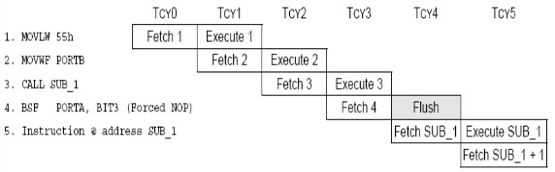
Pipelining in PIC
© Ahmad El-Banna
There are 35 single word instructions. A two-stage pipeline overlaps fetch and execution of instructions. As a result, all instructions execute in a single cycle except for program branches. These take two cycles since the fetch instruction is “flushed” from the pipeline while the new instruction is being fetched and then executed.
A typical picture of the pipeline is shown in Figure 3.
Figure3: Instruction Pipeline Flow
RTES, Lec#3 , Spring 2015

Slide 38
© Ahmad El-Banna
RTES, Lec#3 , Spring 2015

